Slide 1
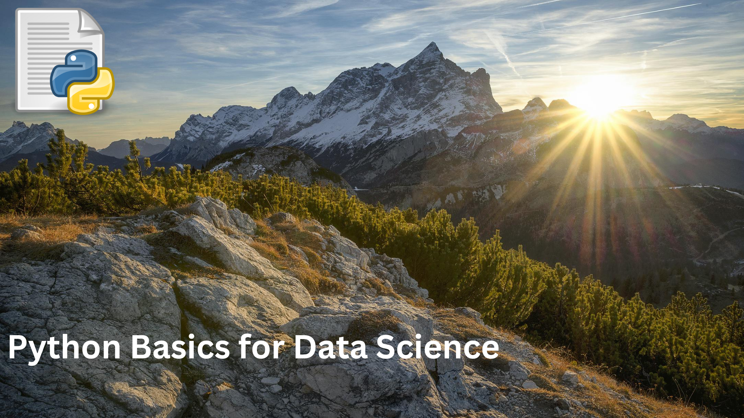

Slide 2
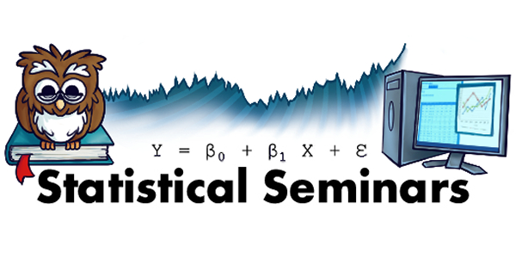
Day 1
Jupyter Notebook
Python basics
Extract Transform Load
Day 2
Strings
Data Visualizations
Exploratory Data Analysis

Slide 3
Rules
We follow Data Community DC code of conduct
Please respect others

Slide 4
Format
Some lecture
Demonstrate with Jupyter notebook
Excerises

Slide 5


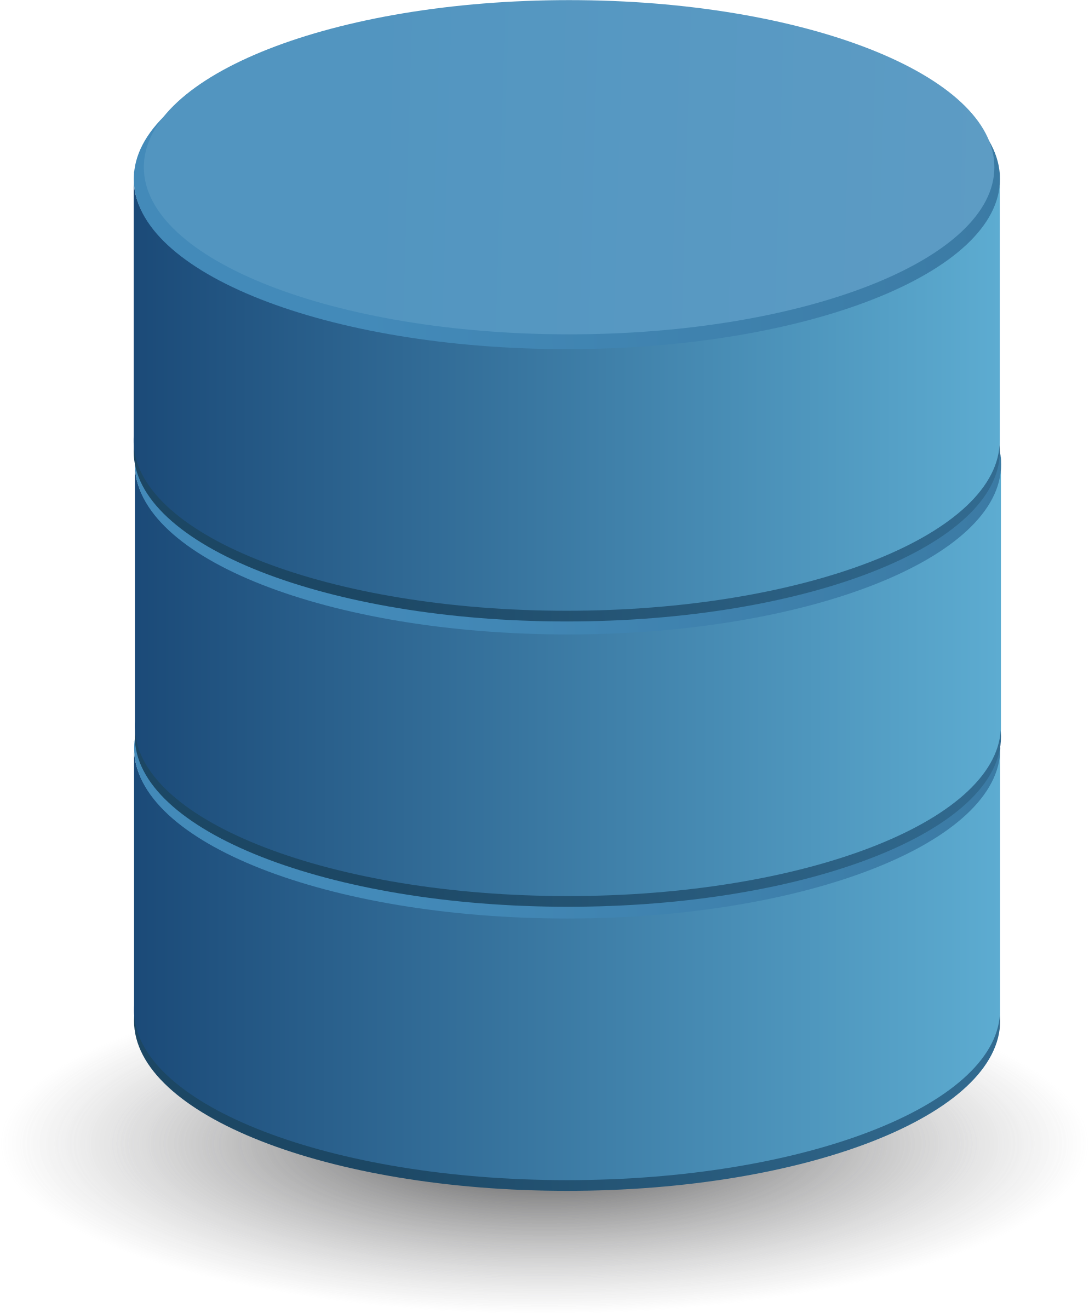


Data Science Life Cycle
Collection
Cleaning
Exploring
Modeling
Deployment

Slide 6
Data Science Life Cycle
Collection
Cleaning
Exploring
Modeling
Deployment

Slide 7
Python
Interpreted high-level programming language for general-purpose programming.
Its powerful... Fast…. Friendly …. and is Open source (Free)
Notes:
Cover geographical statistics

Slide 8

Important features of Python:
Built-in high level data types: strings, lists, dictionaries, etc.
The usual control structures: if, if-else, etc.
Uses functions, modules, and packages.
Object-oriented
Notes:
Cover geographical statistics

Slide 9

Python

Slide 10

Jupyter notebook
open-source web application that allows you to create and share documents that contain live code, equations, visualizations and narrative text.
Notes:
Cover geographical statistics

Slide 11
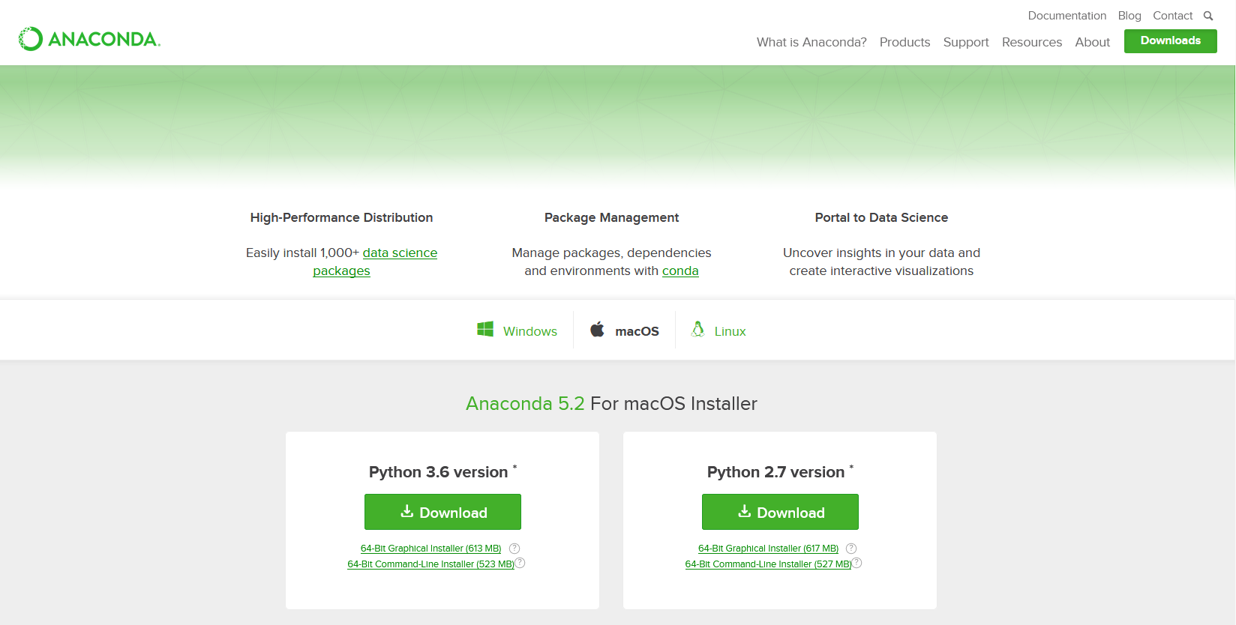
Installation
The easiest way for a beginner to get started with Jupyter Notebooks is by installing Anaconda.
(https://www.anaconda.com/download/#macos)
Notes:
Cover geographical statistics

Slide 12
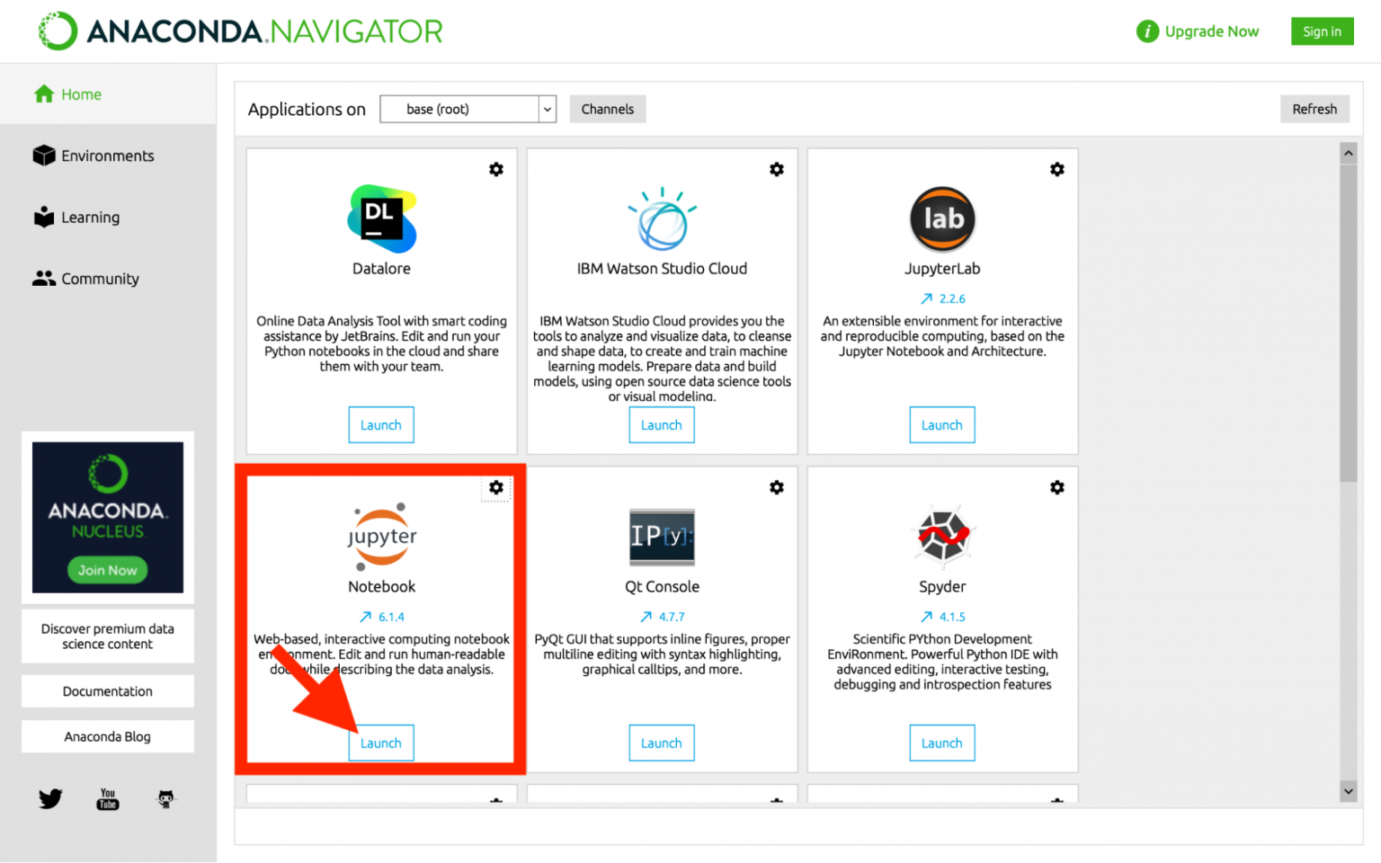
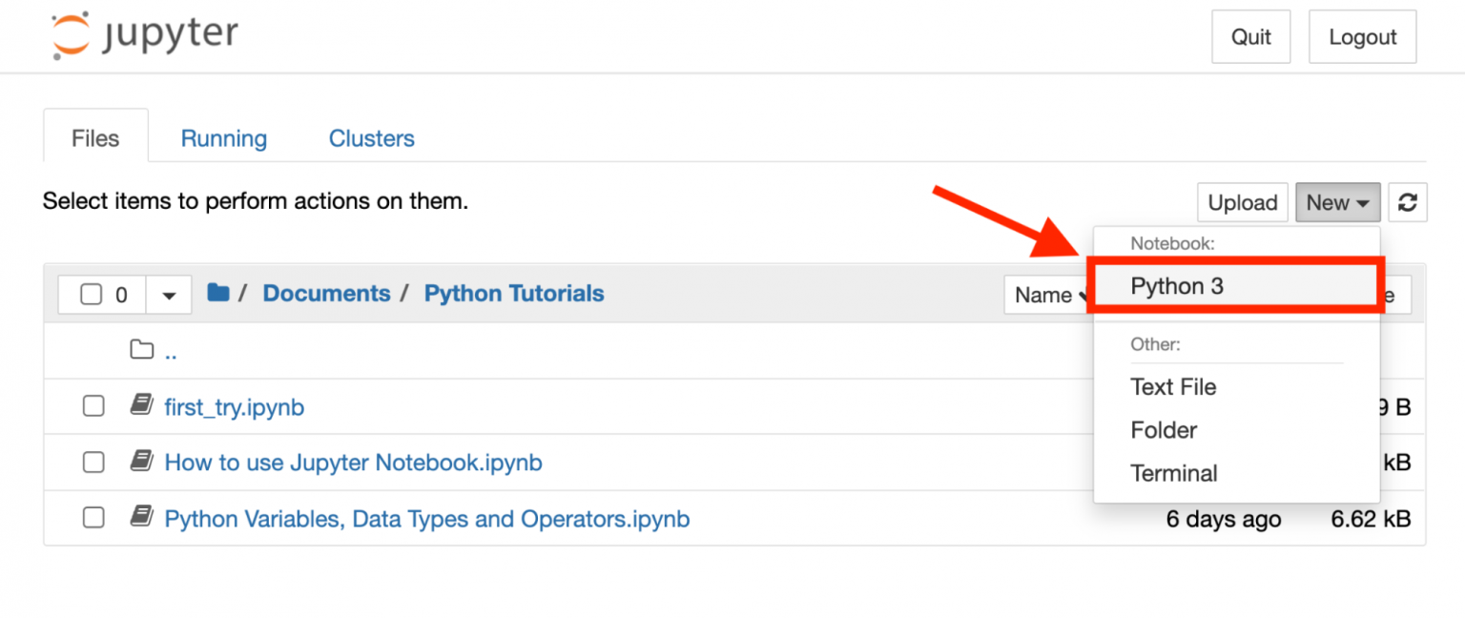
Installation
Notes:
Cover geographical statistics

Slide 13
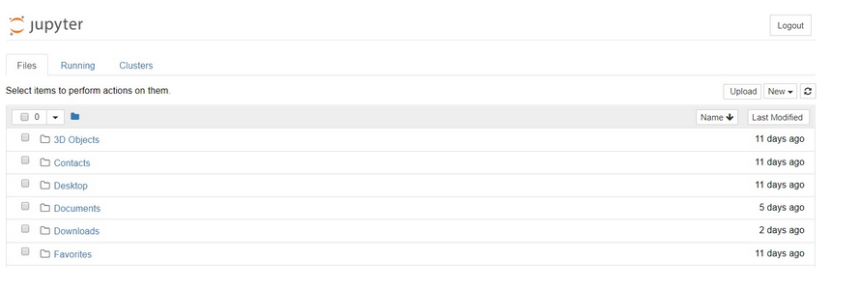
Creating Your First Notebook
run Jupyter via the Anaconda shortcut create within your start menu, a dashboard will appear.
Dashboard
Notes:
Cover geographical statistics

Slide 14
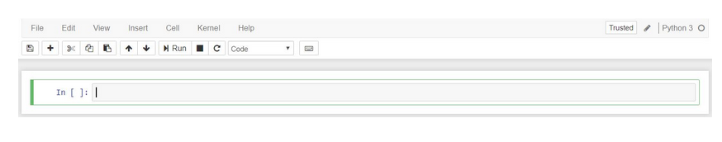
notebook interface
cells and kernels are key both to understanding Jupyter and to what makes it more than just a word processor.
A kernel is a "computational engine" that executes the code contained in a notebook document.
A cell is a container for text to be displayed in the notebook or code to be executed by the notebook's kernel.
A code cell contains code to be executed in the kernel and displays its output below.
Notes:
Cover geographical statistics

Slide 15
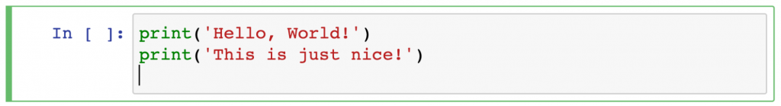
notebook interface
Notes:
Cover geographical statistics

Slide 16
Quick Keys
In command mode:
Scroll up and down your cells with your Up and Down keys.
Press A or B to insert a new cell above or below the active cell.
M will transform the active cell to a Markdown cell.
Y will set the active cell to a code cell.
Notes:
Cover geographical statistics

Slide 17
Python
Variables are used to store values in Python
Assign values to variable using “=”
Variables can be of any type

Slide 18
Python Data Types
Python Types
– Numbers
Floating point (2.0, 3.14159, etc.)
Integers (3, 7, 100, etc.)
– Strings
Sequence of characters (“Hello”, “20003”)
– Lists, tuples, dictionaries

Slide 19
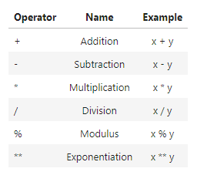
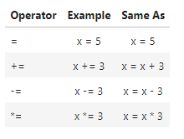
Python Operators

Slide 20
Python Functions
Function name
Define the function
def add_numbers(x,y):
sum = x + y
return sum
add_numbers(5, 6)
Arguments

Slide 21
Python Modules
Python code that can be imported inside another Python Program.
A file that contains a set of functions that you want to include in your application.

Slide 22
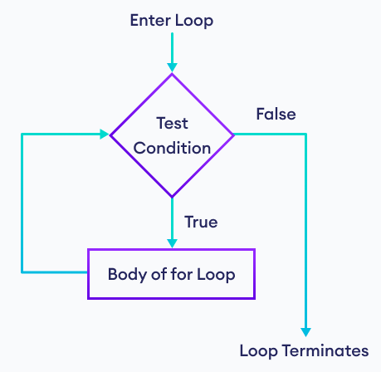
For Loops
for val in sequence:
# statement(s)

Slide 23
For Loops
languages = ['Swift', 'Python', 'Go', 'JavaScript']
# access items of a list using for loop
for language in languages:
print(language)
#output
Swift
Python
Go
JavaScript

Slide 24
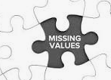
Missing data
occur when no data value is stored for the variable in an observation.

Slide 25
Statistics
Basic Statistics helps use preform data analysis.
Two main statistical methods are used in data analysis: descriptive statistics, which summarizes data using measures like mean and median as well as others, which draw conclusions from data

Slide 26
Mean vs Median
Real use of the median comes when the data set may contain extreme outliers
An outlier will skew the result of the mean to be less representative of the “average” number

Slide 27
Measures of Central Tendency
Mean, Median, mode
Mean: average value for a variable. Sum up all the values then divide by number of observations
Median: the value in the middle of the data when arranged in ascending order
Mode: the value that shows up the most

Slide 28
Measures of Dispersion
Variance, Standard deviation, and Interquartile range
Variance: measure of variability that uses all the data.
Standard deviation: square root of the variance
Interquartile range: based on dividing a data set into quartiles; difference between upper and lower quartiles

Slide 29
Descriptive Statistics
Broken down into a list of measures from the measures of central tendency, variability, or shape.
Used to describe the data series being analyzed.

Slide 30

Exercise / Break

Slide 31
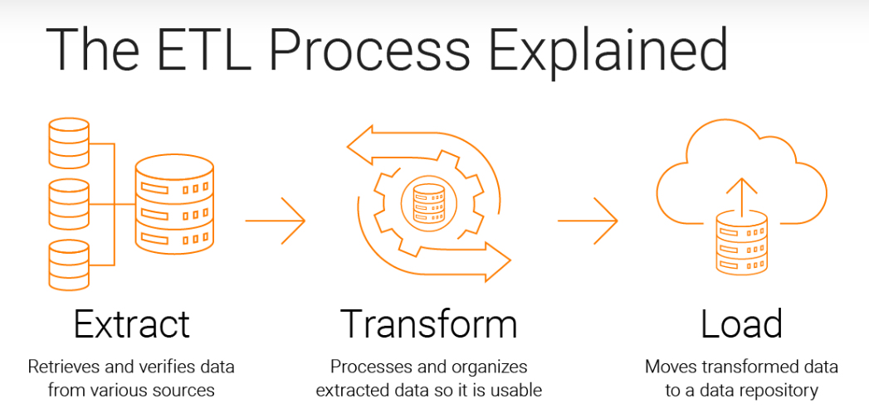
Welcome Back! Extract Transform Load

Slide 32

Importing data
Upload data from external sources and combine it with data you collect via Analytics.

Slide 33
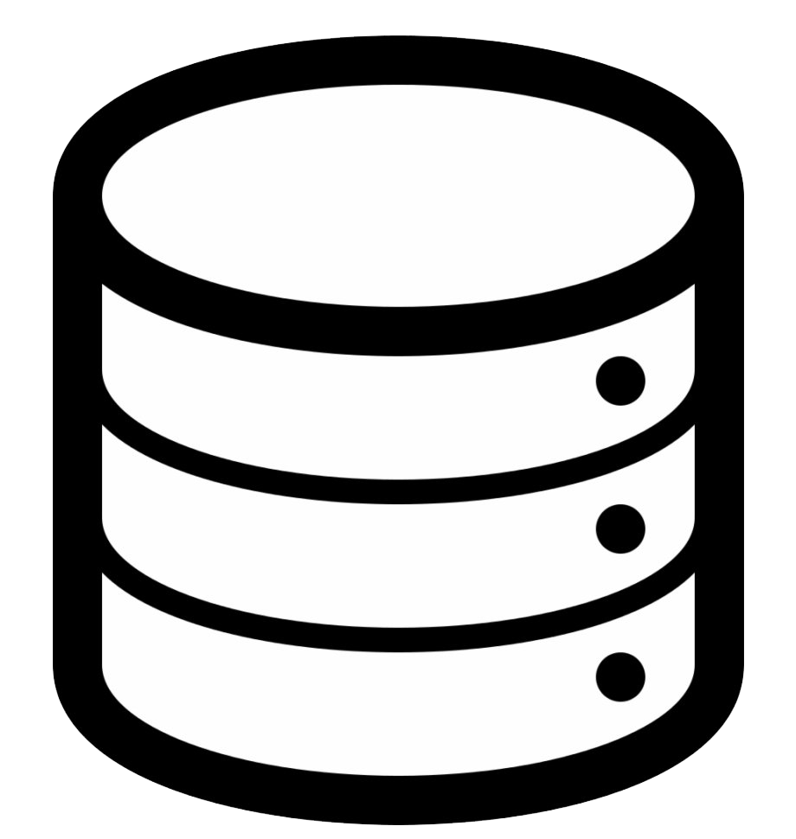


Database
A database is an organized collection of structured information, or data, typically stored electronically in a computer system.

Slide 34

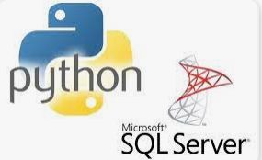

Pyodbc ,

Slide 35
Data wrangling
Data Wrangling is the process of gathering, collecting, and transforming Raw data into another format for better understanding, decision-making, accessing, and analysis in less time. Data Wrangling is also known as Data Munging.

Slide 36
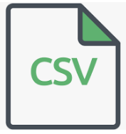
Exporting data
Using functions like to_csv() and to_excel() of a pandas DataFrames can be used in order to export data as a csv or excel file. Apart from csv and excel

